Slide 1

University of New Haven
Connecticut
Spring 2022
AI PROJECT
Presented By-
Pogula Sarvani-00746260
Abhinav Sai Choudary.ch-00753640
Anil Kumar Reddy Allikepalli-00750902
Led by: Shivanjali Khare
Academic Year : 2022
1
Notes:
1

Slide 2

AI Project
Project Objectives
Approach
Presentation Plan
Deliverables
Evaluation methodology
Conclusion
Notes:
2

Slide 3
AI Project
Brain Tumor Detection
For our Ai project, we thought of many fields, topics, and subjects to work on, there is plenty of interesting stuff out there.
1
We decided to choose the topic named brain tumor Detection because many people suffer from this disease and brain tumor detection with Ai can help a lot of doctors with their diagnostic that’s why i chose it
2
Brain tumor is considered as one of the aggressive diseases, among children and adults. Brain tumors account for 85 to 90 percent of all primary Central Nervous System(CNS) tumors. Every year, around 11,700 people are diagnosed with a brain tumor. The 5-year survival rate for people with a cancerous brain or CNS tumor is approximately 34 percent for men and 36 percent for women.
3
3

Slide 4
Project Objectives:
Find a dataSet
Find a model
1
2
Train the model on the dataset
Execute the model into the dataset
3
4
Discuss and show the results
5
4

Slide 5
Approach:
For the approach followed to reach automatic brain tumor detection we choose to use artificial intelligence AI that uses deep learning, which is an artificial neural network to be more precise a CNN.
A convolutional neural network (CNN) is a type of artificial neural network used in image recognition and processing that is specifically designed to process pixel data.
CNNs are powerful image processing, artificial intelligence (AI) that use deep learning to perform both generative and descriptive tasks, often using machine vison that includes image and video recognition
1
2
Then after creating the cnn we will train him to the data set so the model can distinguish between tumorous images and not-tumorous
the training set gonna use the 2 first stets the training and the validation and so we can save the Test set for evaluating our model because it will be non-appropriate to test the model into data that he already saw because he will predict them with an accuracy of 100%.
3
4
After the previous step, we will test our model into the test set and see the result that we are going to get from this testing, and then we will be able to answer if our model is good or bad
5
5

Slide 6
Deliverables:
Data set
Code in a notebook
1
2
The model after training
Screen Shot for the execution
4
3
6

Slide 7
Evaluation Methodology:
Firstly we present our model via CNN with just some fully connected layers.
We describe the total number of parameters in the model.
We then start training our model and after we finish training our model we go to the part where we evaluate our model to see if it's a good model or if it needs improvements.
We evaluate the accuracy of the model by looking for a bigger DATASET and see if it is good or bad and if there are any changes to be made we improve it accordingly.

Slide 8
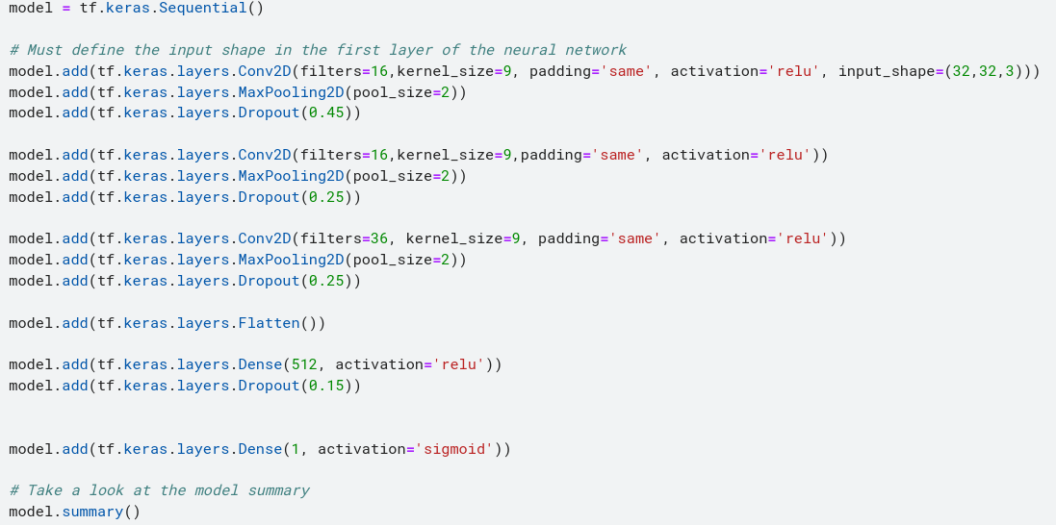
Here is the following model that created via CNN with fully connected layers.

Slide 9
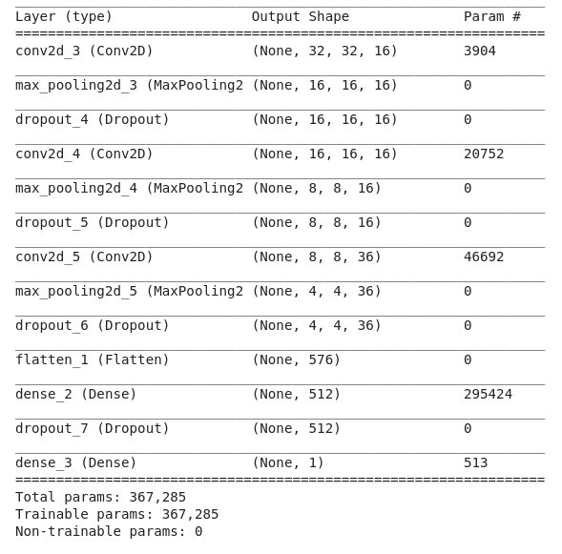
And here is the result for the model summary that shows our model in detail and specifies the total parameters of the model

Slide 10
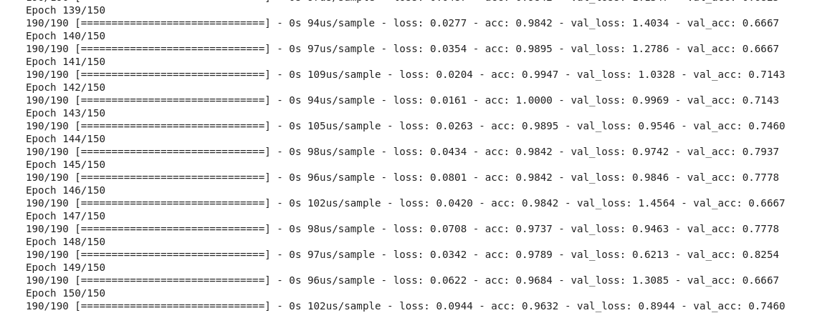
Then we start train our model for 190 epochs just as shown in the figure below

Slide 11
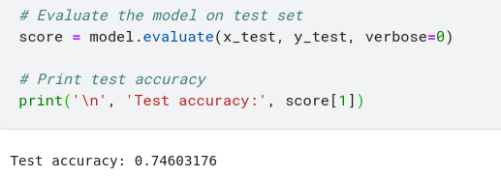
After we finish training our model we now go to the part where we evaluate our model to see if it's a good model or if it needs improvements.
As we can see the accuracy of our model is at 74.6% it is not that bad but its good and we can still improve this result by looking for a bigger DATASET.

Slide 12
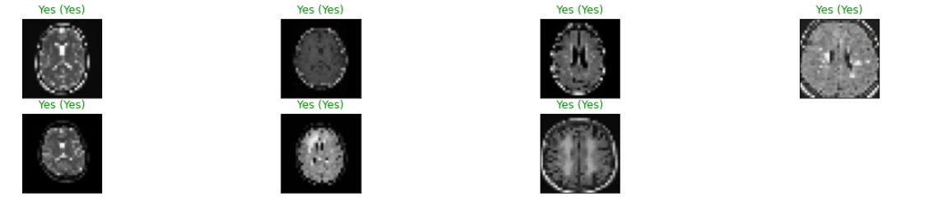
and here are some results for the model when we run it on the test pictures
between the brackets is the correct prediction so we can say that our model gave pretty much good results

Slide 13
Conclusion:
This project was a combination of CNN model classification problem (to predict wheter the subject has brain tumor or not) & Computer Vision problem (to automate the process of brain cropping from MRI scans).
The final accuracy is much higher than 50% baseline (random guess). However, it could be increased by larger number of train images or through model hyperparameters tuning.
13

Slide 14
Thank You

